Slide 1
THE AMAZING HUMAN BRAIN AND MIND
THE MIND BODY CONNECTION
“I will praise thee; for I am fearfully and wonderfully made: marvellous are they works; and that my soul knoweth right well”
Psalms 139:14

Slide 2
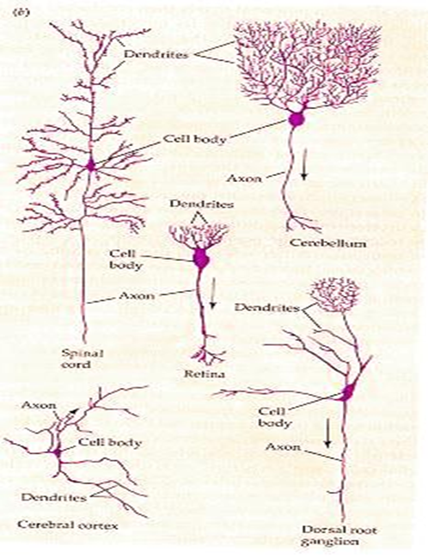
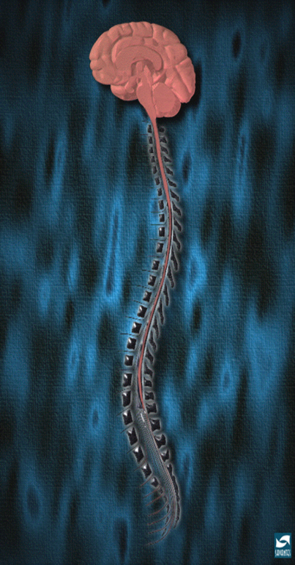
THE MIND BODY CONNECTION
In vertebrates, the spinal cord contains neural circuitry capable of generating reflex responses as well as simple movement such as swimming or walking.
Sophisticated complex sensory input requires the information-integrating capabilities and control of behavior on the basis of a centralized brain.
“Health is a treasure. Of all temporal possessions it is the most precious.” CDF, p.20

Slide 3
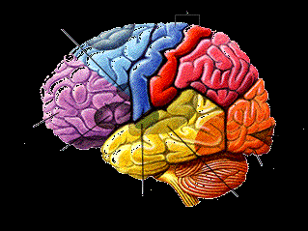
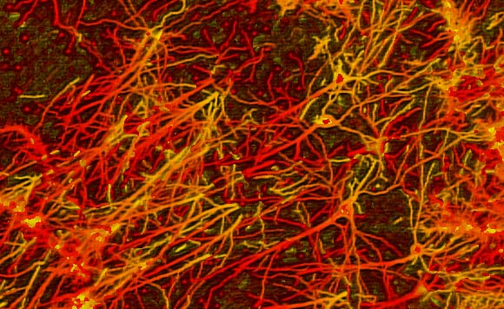
THE MIND BODY CONNECTION
A human brain weighs between 3 to 3.5 pounds, has about 50 to 100 billion neurons creating a central area of the body to serve as its functional communication center.
These cells pass signals to each other via approximately 100 trillion synaptic connections.
The brain’s high demand for oxygen and nutrients is reflected in its domination of the body’s percentage of blood supply at rest.

Slide 4
THE MIND BODY CONNECTION
The human brain requires nearly 20% of the blood supply while only retaining about 2% of the total human body weight in an average adult. 750 milliliters of blood flow into your brain every minute, regardless of whether or not the body’s movement has altered, slowed, or hastened.
If blood flow demand goes unmet, your brain could shut down and make the body lose consciousness. The brain is created by the most delicate and sensitive tissue in the body. The metabolic rate of the brain is not only oxygen hungry, but requires constant nutrients in order to function as well as an ample waste removal system.
It is important to learn to understand the physical structure of the brain, it will can provide foundation and insight to the complex distinctions of human behavior.

Slide 5
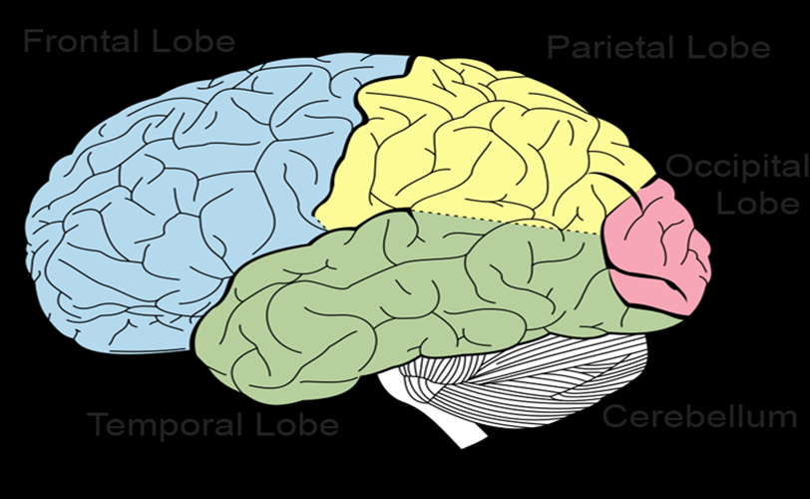
THE MIND BODY CONNECTION
The brain acts as a control center, receiving, interpreting, and directing sensory informa -tion throughout the body.
Anatomically the structure of the brain has three major parts, the forebrain, the hindbrain, and the brainstem.
Cerebrum (The Forebrain) is the largest area of the brain and is concerned with all higher mental functions, such as thinking and memory, made of two hemispheres.
The right cerebral hemisphere controls the left side of the body and the left cerebral hemisphere controls the right side of the body.

Slide 6
THE MIND BODY CONNECTION
Each cerebral hemisphere is divided into four areas, known as lobes: frontal, parietal, occipital, and temporal lobes and a base – Cerebellum/Brainstem.
Each cerebral hemisphere is divided into four areas, known as lobes: Frontal Lobe handles complex thoughts involving planning, organizing, problem solving and selective attention. Anterior (front) portion of the frontal lobe is called the prefrontal cortex, very important for "higher cognitive functions" including behavior and emotions and the determination of the personality. Posterior/back of frontal lobe consists of motor and premotor nerve cells areas that produce movement located in motor areas. Premotor areas modify movements. Frontal lobe is divided from the parietal lobe by the central culcus.

Slide 7
THE MIND BODY CONNECTION
Parietal Lobe contains the primary sensory cortex which controls sensations like touch or pressure. Behind the primary sensory cortex is a large association area control-ling fine sensation which are judgment of texture, weight, size or shape.
Occipital Lobe processes visual information including responsibility for visual reception; also contains association areas that help in the visual recognition of shapes and colors. Damage to this lobe can cause visual deficits.
Two Temporal Lobes, on each side of the brain at about the level of the ears allow a person to tell one smell from another and one sound from another, and also help to sort new information responsible for short-term memory.

Slide 8
THE MIND BODY CONNECTION
Right Lobe involved mainly in visual memory like pictures and faces; left lobe involved mainly in verbal memory such as words and names.
Cerebellum/Hindbrain is the back part of the brain and concerned with balance and coordination – activities carried out automatically or subconsciously by this area of the brain and are not under a person's control.
The cerebellum is not very well understood. Brain stem controls the basic functions essential to maintaining life, including blood pressure, breathing, heart beat, eye movements and swallowing. It is the bottom part of the brain and connects the cerebral hemispheres to the spinal cord.

Slide 9
THE MIND BODY CONNECTION
Difference Between Brain & Mind
We often use the words ‘brain’ and ‘mind’ interchangeably even though they really refer to separate things.
The brain and computer have somethings in common, but in many more ways are more different than they are similar.
Both combine processes from their components and parts to perform tasks such as motherboard, disk drives, processor, graphic cards and each has its own roles and functions.
The brain has the cerebrum, cerebellum, medulla oblongata, thalamus and numerous other parts. Computer requires hard -ware to perform functions and needs software to run. With-out software, the hardware is useless; without hardware, software is useless. Both are used to store information, process the information and perform tasks.

Slide 10
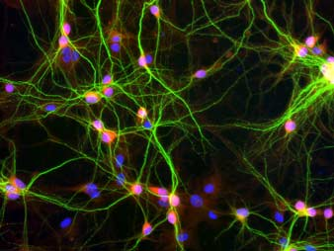
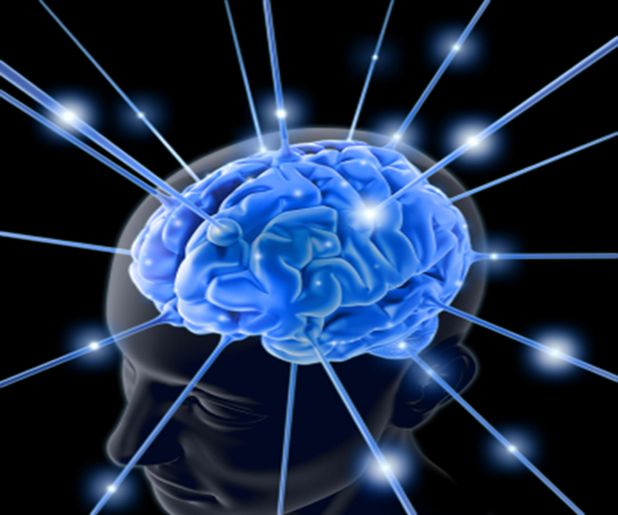
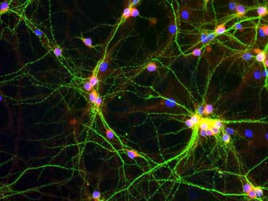
HUMAN BRAIN AND MIND
Hippocampal Neurons
The brain is an organ or the physical place where the mind resides; it is a vessel in which the electronic impulses that create thought are contained.
Brain coordinates your movements, your body functions, other activities and transmit impulses.
.

Slide 11
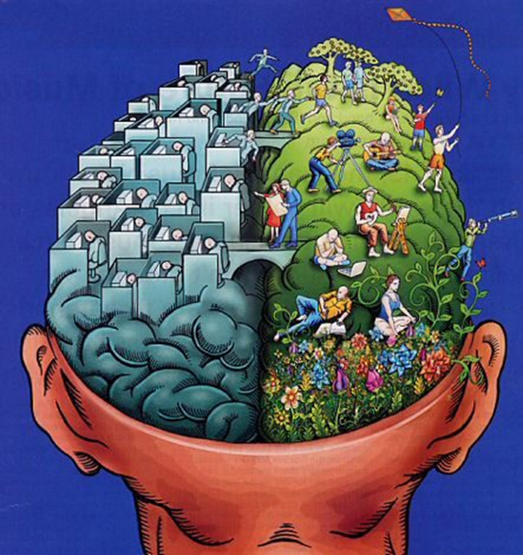
THE MIND BODY CONNECTION
With the mind we think, manifest actions of thought, perception, determination, memory and imagination, meditation, and emotion, within the brain.
Mind has consciousness, and awareness, as well as the ability to control what we do, and know what we are doing and why, the ability to understand our surrounding environment.
Animals are able to interpret their environments, but not understand them. While the mind generally refers especially to the thought processes of reason.

Slide 12
THE MIND BODY CONNECTION
“All need to be acquainted with that most wonderful of all organisms, the human body. They should understand the functions of the various organs and the dependence of one upon another for the healthy action of all They should study the influence of the mind upon the body, and the body upon the mind, and the laws by which they are governed. MH p.128.
“We cannot be too often reminded that health does not depend on chance. It is a result of obedience to law. This is recognized by the contestants in athletic games and trials of strength……… Every habit is carefully regulated. ….. Neglect, excess, or carelessness, which weakens or cripples any organ of function of the body, would ensure defeat.” MH, p. 128

Slide 13
THE MIND BODY CONNECTION
“Disease never comes without a cause (Prov. 26:2).
The way is prepared, and disease invited, by disregard of the laws of health.” MH, p.234.
“Too little attention is generally given to the preservation of health. It is far better to prevent disease than to know how to treat it when contracted.”
“We are waging a warfare upon which hang eternal results………….Evil angels are striving for dominion of every human being. Whatever injures the health, not only lessens physical vigor, but tends to weaken the mental and moral powers. Indulgence in any unhealthful practice makes it more difficult for one to discriminate between right and wrong, and hence more difficult to resist evil. It increases the danger of failure and defeat.” MH, p.128

Slide 14
THE MIND BODY CONNECTION
Logic makes man able to understand things are not as what they seem. Man’s ability to analyze situations makes it possible to develop solutions to problems and lead us toward practical solutions.
“The body is the only medium through which the mind and soul are developed for the upbuilding of character. Hence it is that the adversary of souls directs his temptations to the enfeebling and degrading of the physical powers. His success here means the surrender to evil of the whole being. The tendencies or our physical nature, unless under the dominion of a higher power, will surely work ruin and death.” CDF, p.73.

Slide 15
THE MIND BODY CONNECTION
“If we carefully preserve the life force, and keep the delicate mechanism of the body in order, the result is health.” “Without health, no one can as distinctly understand, or as completely fulfill his obligations to himself, to his fellow-beings, or to his Creator. Therefore, the health should be as faithfully guarded as the character.” MH , p 235; Evangelism, p. 195
Stages of scientific advancement have usually been made by trying to reach a logical conclusion consistent with our observations.
Humans can be used to solve complex logical problems and able to interpret and understand what happens around them and adapt, even if they do not understand the scientific reasoning for it.

Slide 16


THE MIND BODY CONNECTION
We know and believe that viruses, bacteria, genetic defects, and environmental pollution are real causes of disease.
We may not be able to see in the ultraviolet range, but we may design instruments to do so. We may not be able to see atoms, but we can design experiments that enable us to know their properties.

Slide 17
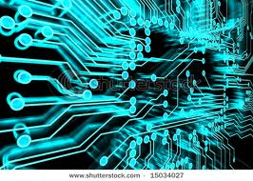
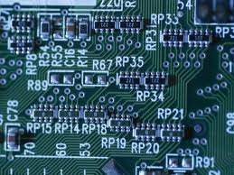
THE MIND BODY CONNECTION
Both the computer and brain transmit information by using electrical signals to each of their parts.
Computer components transmit electrical signals through conductors via cables, wires and circuits, artificial, stronger electrical signals that travel many times faster than those of the brain. It uses switches that are either on or off (binary).

Slide 18
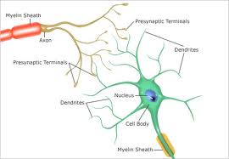
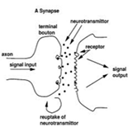
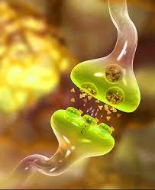
THE MIND BODY CONNECTION
Brain cells signal each other electro-chemically and enzymatically. The human brain uses tiny chemical reactions to produce weak electrical signals to communicate with its other parts.
Neurons in the brain are either on or off by either firing an action potential or not firing an action potential. But, neurons are more than just on or off because the "excitability" of a neuron is always changing. This is since a neuron is constantly getting information from other cells through synaptic contacts.

Slide 19
THE MIND BODY CONNECTION
Information traveling across a synapse does not always result in a action potential, rather, this information alters the chance that an action potential will be produced by raising or lowering the threshold of the neuron.
Emotions vs Logic It is impossible for the brain to act without emotions while the computer acts only on logic. Researchers have proved that brains act on emotions, that many of our actions are based on our emotional side. We know that computers act completely on logical bits, that are total absolute. All actions performed by computers are based on the instructions in their coding and other factors have no effect on them.

Slide 20
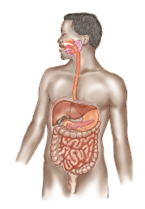
THE MIND BODY CONNECTION
“The state of the mind has largely to do with the health of the body, and especially with the health of the digestive organs…………As a general thing, the Lord did not provide His people with flesh meat in the desert, because He knew that the use of this diet would create disease and insubordination. In order to modify the disposition, and bring the higher powers of the mind into active exercise, he removed from them the flesh of dead animals. He gave them angels’ food, manna from heaven.” CDF, p. 375.

Slide 21
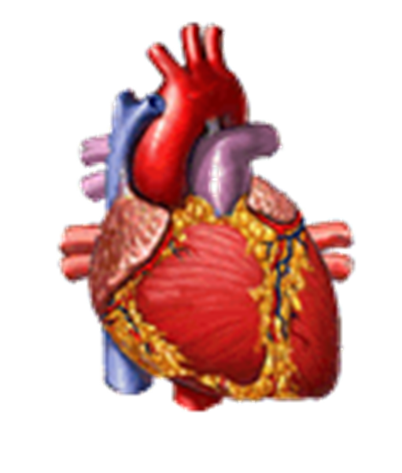

THE MIND BODY CONNECTION
Diseases of the nervous system as with other systems of the body pose serious health problems.
Multitasking The brain controls breathing, heart rate and blood pressure at the same time it performs a mental task.

Slide 22
THE MIND BODY CONNECTION
Working hours The computer can be turned off when not in use, but the brain and body works for 24 hours a day, always changing and being modified. There is no "off" for when we are sleeping, the mind and body are still active and working. When the power to a computer is turned off, signals are not transmitted.
Complexity The brain has 100 billion neurons which form billions of links is many times more complex than, the mere hundreds of millions of transistors and circuit in computers. Thousands of neuroscientists are study-ing the brain. However, there is still soo much more to learn about the brain and body because of their complexity. There is more we do NOT know about the brain and body, than what we do know about them.

Slide 23

THE MIND BODY CONNECTION
Brainwaves
Electrical activity of the brain measured in cycles per second or Herzt (Hz) is called brainwaves because of its cyclic, wave-like nature. Brainwave
patterns change depending on what the
person is doing. e.g., brainwave patterns
when we sleep are very different than
brainwaves when we are wide awake.
There are four categories of brainwaves, ranging from the most activity to the least activity.
Beta Brainwaves of low amplitude 12Hz-38Hz are fastest of the four different brainwaves, and associated with waking activity.

Slide 24
THE MIND BODY CONNECTION
They are emitted when consciously alert or feel agitated, tense and afraid. Beta waves are characteristic of a strongly engaged mind. A debater, or a teacher, or a host of talk show would all be in beta state when doing their work. Usually, this state in itself is uneventful but we should not understi-mate its importance.
Lack of beta brainwave activity can cause mental or emotional disorders such as depression and insomnia. Stimulating beta brainwave can improve emotional stability, energy levels, attentiveness and concentration.

Slide 25

THE MIND BODY CONNECTION
Alpha Brainwave 8Hz-12Hz
(Relaxed) can be found when we
are awake but in a state of physical
and mental relaxation. We are still
aware of what is happening around
us.
Light meditation and day dreaming are associated with alpha brainwave. You are also in alpha state when you get up in the morning and just before you sleep.

Slide 26
THE MIND BODY CONNECTION
Since Alpha brainwave is very receptive and absorbent mental state, you can use it to practice your creative visualization and auto suggestion technique. Its are also good for mental reprogramming and accelerated learning.
You will go to theta brainwave 3Hz-8Hz (Dream) when you are in light sleep or extreme relaxation. It is a state of somnolence with reduced consciousness. Theta brainwave are associated with creativity, dreams and Extra-sensory perception. Theta brainwaves are also be used for mental reprogramming.

Slide 27
THE MIND BODY CONNECTION
Delta brainwave 0.2Hz-3Hz (Deep Sleep) are the slowest band of brainwaves, occur during deep sleep or catalepsy. loss of body awareness occurs. During delta state, you do not dream and the brain is fully unconscious but it is important because the body is healing itself and resetting its internal clocks, human growth is also released.
Knowledge of brainwaves state will give you the ability to make use of specific characteristic of those states such as being intensely focused, relaxed, creative and restful sleep.
Although there are four different kind of brainwaves, but the truth is they are not really separate brainwaves, but are categorized just for convenience.

Slide 28
THE MIND BODY CONNECTION
One brainwave state my predominate depending on the activity of the individual, but the remaining three brainwaves are still present in the mix of brainwaves at all times. So, we don't ever produce only one brainwave type at a time. As an example, while somebody is wide awake, he produce a high amount of beta brainwave. A component of alpha, theta and delta brainwaves are still exist with only at the trace level.
“The relation that exists between the mind and the body is very intimate. When one is affected, the other sympathizes. The condition of the mind affects the health to a far greater degree than many realize………… Disease is sometimes produced, and is often greatly aggravated, by the imagination. Many are lifelong invalids who might be well if they only thought so.” MH, p.241.

Slide 29
THE MIND BODY CONNECTION
“God is as truly the author of physical laws as He is author of the moral law. His law is written with His own finger upon every nerve, every muscle, every faculty, which has been entrusted to man. C.O.L. , pp. 347, 348.
“One reason why we do not enjoy more of the blessing of the Lord is, we do not heed the light which He has been pleased to give us in regard to the laws of life and health.”
R & H May 8, 1883.
“Know ye not that your bodies are the members of Christ?” “What! Know ye not that your body is the temple of the Holy Ghost which is in you, which ye have of God, and ye are not your own? For ye are bought with a price; therefore glorify God in your body and in your spirit, which are God’s.” 1Cor. 6:15, 19, 20.

Slide 30
THE MIND BODY CONNECTION
“Our bodies are Christ’s purchased property, and we are not at liberty to do with them as we please. 6T , pp. 369, 370.
“Let this mind be in you which was also in Christ Jesus.”
(Philippians 2:5). Having the mind of Christ is the highest form of education that anyone can obtain. From the begin-ning god ordained that the mind and body be disciplined, educated and trained for service of God and man. Regard less of our station in life, God has entrusted each of us with minds and bodies to develop and glorify His name. God has given us the ability and responsibility to develop, improve, and cultivate the gifts, abilities and talents given us. God’s plan is that we continually grow in the knowledge, wisdom and stature of our Creator throughout our lifetime in preparation for the world to come.

