Slide 1
Starting a Country Sanitarium or City Medical Missionary Work

Slide 2
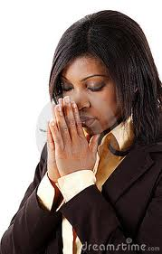
Know you are called
Through the scriptures, the Holy Spirit, providential working
Much prayer
Truly converted
Long hours, little money,
but very rewarding

Slide 3
Faithful is he that calleth you, who also will do it. 1Thess 5:24
No man is called by God, in the use of the talents entrusted to him, to lay off his individual responsibility that another man may do his trading for him. {TDG 286.3}

Slide 4
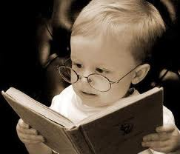
Study and Live the health message
You should already be convicted and committed to living in harmony with God’s health laws to be able to set an example to your guests. Do not divert one iota.

Slide 5
Neither as being lords over God's heritage, but being examples to the flock. 1Peter 5:3
The light which God has given upon health reform cannot be trifled with without injury to those who attempt it; and no man can hope to succeed in the work of God while, by precept and example, he acts in opposition to the light which God has sent.-- Special Testimony for Ministers and Workers, No. 7, p. 40

Slide 6
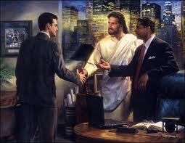
Get a converted, committed partner
Pray, counsel, study, and work together

Slide 7
…sent them two and two before his face into every city and place, whither he himself would come. LK 10:1 The workers should go forth two by two, that they may pray and consult together. Ev520

Slide 8
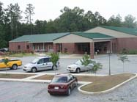
Get training
Go to a medical missionary training program or volunteer in a center.
You will learn in the work, so don’t think you have to know everything before you start.

Slide 9
Study to shew thyself approved unto God, a workman that needeth not to be ashamed. 2Tim 2:15
The workers should receive training, that they may labor discreetly and intelligently. Letter 172, 1909, p. 3

Slide 10
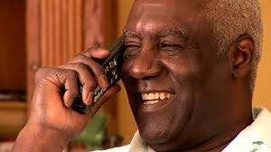
Get counsel
Make calls, visit other established centers, volunteer to help in a center. This will minimize mistakes in your ministry.

Slide 11
Where no counsel is, the people fall: but in the multitude of counsellors there is safety. Prov 11:14
You may expend energy sufficient for the highest success, yet you will fail of achieving good and permanent results unless you are willing to receive instruction and to learn wisdom by receiving counsel of others. {15MR 239.2}

Slide 12
Objectives
Primary goal is soul winning

Slide 13
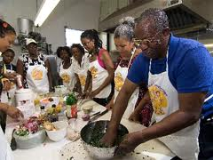
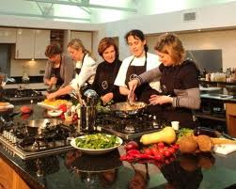
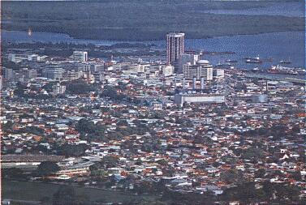
City ministry
Seminars, cooking classes, treatment rooms, food and book store

Slide 14
Country ministry
Live-in guests, garden, scheduled seminars in town

Slide 15
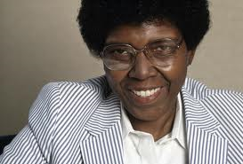
Always have your ministry a place where you train others. Invite interns to work with you.

Slide 16
But ye shall receive power, after that the Holy Ghost is come upon you: and ye shall be witnesses unto me both in Jerusalem, and in all Judaea, and in Samaria, and unto the uttermost part of the earth. Acts 1:8
Medical missionary work gives opportunity for carrying forward successful evangelistic work. It is as these lines of effort are united, that we may expect to gather the most precious fruit of the Lord.--Review and Herald, Sept. 7, 1905

Slide 17
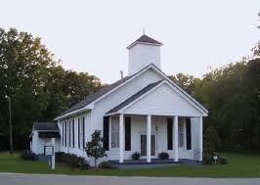
Solicit support of local churches
Present your plans
Give reports
Invite them to attend seminars
Solicit volunteers

Slide 18
And he reasoned in the synagogue every sabbath, and persuaded the Jews and the Greeks. Acts 18:4
The workers are not to stand apart from one another, but work together in everything that interests the cause of God. LS303
If they turn aside, as did Solomon, to work contrary to God's designs, then the Lord cannot cooperate with them.--MS 58, 1904.

Slide 19
Facility
Start with what you have, grow as God blesses
you. When ready to expand, look for a facility that already has buildings and fruit orchards
Minimal-- extra bedroom
Keep things simple
Shun display
Clean, cheery, peaceful

Slide 20
If possible, properties on which there already are suitable buildings, or on which there are orchards in bearing should be purchased on which to establish schools. {2SAT 225.2}
Those whose affections are set on God will succeed... It is not ostentation, outward show, that gives a correct representation of the work that we, as God's chosen people, are to do. {7T 90.2}

Slide 21
Equipment needed
Rooms for employees, interns, guests
Bathtub, (prefer whirlpool), shower, towels, microwave for heating fomentations, basins, electric teapot, kitchen supplies, computer and projector.
In sanitarium, need two treatment rooms, one for male and one for female. Plan ahead for expansion by make them big enough and private for more than one treatment to be given at the same time.

Slide 22
If the iron be blunt, and he do not whet the edge, then must he put to more strength: but wisdom is profitable to direct. Ecc 10:10
But my God shall supply all your need according to his riches in glory by Christ Jesus. Phil 4:19
Wealth or high position, costly equipment, architecture or furnishings, are not essential to the advancement of the work of God; neither are achievements that win applause from men and administer to vanity. MH37
The Lord is glorified when the equipment and workings of an institution show good judgment. {NebRep, February 28, 1905

Slide 23
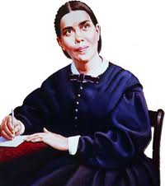
Standards, Guidelines
All guidelines based on Bible and writings of EG White

Slide 24
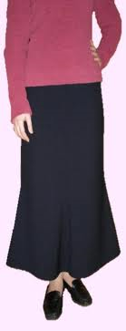
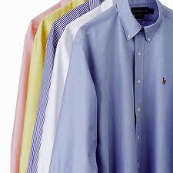
Specific areas: Finances, food details (% raw, sugar, oil, fruit mixed with vegetable, analogues, gluten, yeast flakes, # meals served each day…all can bring controversy), same gender treating same gender, dress code (length of dresses, neckline, form fitting, shoe type, appropriate male dress), hours of operation.

Slide 25
Form a board (uneven #, 5 is a good number for a small center)
Develop a mission statement
Develop a logo

Slide 26
But this thing commanded I them, saying, Obey my voice, and I will be your God, and ye shall be my people: and walk ye in all the ways that I have commanded you, that it may be well unto you. Jere 7:23
We may all do a good work in blessing others, if we will seek counsel of God, and follow on in obedience and faith. LHU176

Slide 27
Employees
If you will be hiring employees, screen them well, pray much. Do not be tempted to hire someone you are not sure of just because you need to fill a position. It is better to get a converted worker than someone who is not, but who has worldly credentials: MD, RN, LMT… Medical missionary work is a simple work. Workers who are obedient to God and willing to be lead by Him are what you are looking for.

Slide 28
He that is faithful in that which is least is faithful also in much: and he that is unjust in the least is unjust also in much. Luke 16:10
The Lord calls for consecrated workers. He has no use for the half-hearted lovers of pleasure more than lovers of God. {6MR 226.1}

Slide 29
Seminars
There are many good seminars available. Dr Mark Sandoval, John Clark, Neil Nedley, Abundant Living, Walter Veith, Vicki Griffin, Dr Wes Youngberg, Rob McClintock, and others.
Start by using some of these.
Contact other Medial Missionaries, they will be glad to share materials with you.

Slide 30
Teaching them to observe all things whatsoever I have commanded you: and, lo, I am with you always, even unto the end of the world. Amen. Matt 28:20
We must educate, educate, educate, pleasantly and intelligently. MM262

Slide 31
Finances
Stay out of debt
Solicit help from someone who is a good money manager. A good ministry must also be wise in business.
Plan on other source of income other than your health guests, such as, food and book store, agriculture, or an outside business.
Do not be timid in asking those of means to help, and sacrificial gifts of others

Slide 32
For which of you, intending to build a tower, sitteth not down first, and counteth the cost, whether he have sufficient to finish it? Lk 14:28
The rich ruleth over the poor, and the borrower is servant to the lender. Prov 22:7 It is the Lord's money which the wealthy men of the world have, and we should not hesitate to ask them to impart of the Lord's goods for the establishment of sanitariums, which are a benefit to all classes of people. {PUR, September 26, 1901 par. 19}

Slide 33
Six Musts
You must be willing to be used by God for the salvation of souls.
You must have solid, confident, undoubting faith.
You must be diligent, persevering and determined to complete your mission.
You must have Christ-like humility.
You must have a genuine love for souls.
You must be willing to give up everything for the service of God.

Slide 34
Remember
All His biddings are enablings. COL 333

