Slide 1
Organic Gardening: An Agricultural Practice for 21st Century
David T Chand
Assistant Professor,
Teacher Education Department,
School of Education and Human Sciences
University of the Southern Caribbean

Slide 2
Organic Gardening
Outline of the Presentation
Theological Context of Agriculture
Definitions of Agriculture
Land: An Important Resource of Production
Organic Gardening
Sir Albert Howard: Father of Organic Farming
Organically Produced Plants
Benefits of Organic Gardening
Requirements for Organic Gardening
Vermiculture

Slide 3
Objectives of Organic Gardening
To create awareness of the practice of organic Agriculture and organic gardening
To know and understand the benefits of organic gardening
To promote healthy living through the practice of organic gardening

Slide 4
theological Context of Agriculture
According to the Bible
“And the Lord God took the man, and put him into the garden of Eden to dress it and to keep it” (Genesis 2: 15 )
What does this biblical text suggest to us about the work assigned to Adam?
It suggests of agricultural work.

Slide 5
theological Context of Agriculture
According to Mrs. White
Agriculture was the
Useful occupation
a blessing
Strengthens the body,
Expands the mind,
Develops character (Education p.21)

Slide 6
Definitions of Agriculture
The word ‘agriculture’ is derived from Latin words: ‘agri’ from ‘agrarius’ meaning ‘of the land’ and ‘cultura’ from ‘culture’ meaning ‘to till or cultivate’.
Henry defines agriculture as “the business of growing crops and rearing animals through application of scientific principles and facts acquired over period of time” (1991,p1)
According of Baldeo “Agriculture is defined as purposeful work through which the elements in nature are harnessed to produce plants and animals to meet human needs”.

Slide 7
Definitions of Agriculture
Mrs. White writes agricultural work is “the occupation most favorable to development- the plants and animals” (Education, p 21).
She further emphasizes, “No line of manual training is of more value than agriculture” (Education, p 219).

Slide 8
Land: is an important resource of production
“They were tillers of the soil and keepers of flocks and herds and in this free, independent life, with its opportunities for labor and study and meditation, they learned of God and taught their children of His works and ways” (White, 1903, p.34).

Slide 9
Organic gardening
This is a kind of agricultural practice that involves use of plant and animal resources for growing foods for our use in our backyards or any available land spaces.
We use natural ways to cultivate soil and rear animals.
In organic gardening we make use of organic manures to increase humus in the soil.
The use of chemical fertilizers is minimized if not, avoided at all cost.
Organic gardening draws conceptually from organic agriculture

Slide 10
Sir Albert Howard: Father of Organic Farming
Sir Albert Howard’s practice of organic agriculture gives him the title of being “father of organic farming”.
His best publication of “An Agricultural Testament” in 1940 is still the most referred source on organic farming.
He focuses on natural processes in organic farming.
Interestingly, he worked in India as an agricultural advisor to central states at that time.

Slide 11
Organically Produced Plants
All plants can be cultivated organically.
Horticulture, specifically looks into production of vegetables, fruits, and ornamental plants.
These can grow through the practice of organic gardening. The green leafy vegetables like Lettuce, Patchoi, Spinach (Bhagi), Cabbage can be grown easily in a short period of time.
The root crops like Cassava, Yam, Dasheen, Tannia etc can be cultivated in our yards at home.
Tomatoes and Melongene can also be grown.
Fruits like Banana, Papaya, and Citrus can be grown in home gardens.
Lilies, Orchids, Roses, also grow in soil enriched organically. Plant based foods most of them can be home-grown.

Slide 12
benefits of organic gardening
Organic gardening provides healthy nutritious food for our consumption. These foods are free from chemicals that cause harmful effects to our human body.
Vegetables and fruits are supplied fresh from the garden that build our health and protect us from sickness and diseases.
We can save our financial resources through its practice.
It affords us opportunities to raise funds for church and community projects.

Slide 13
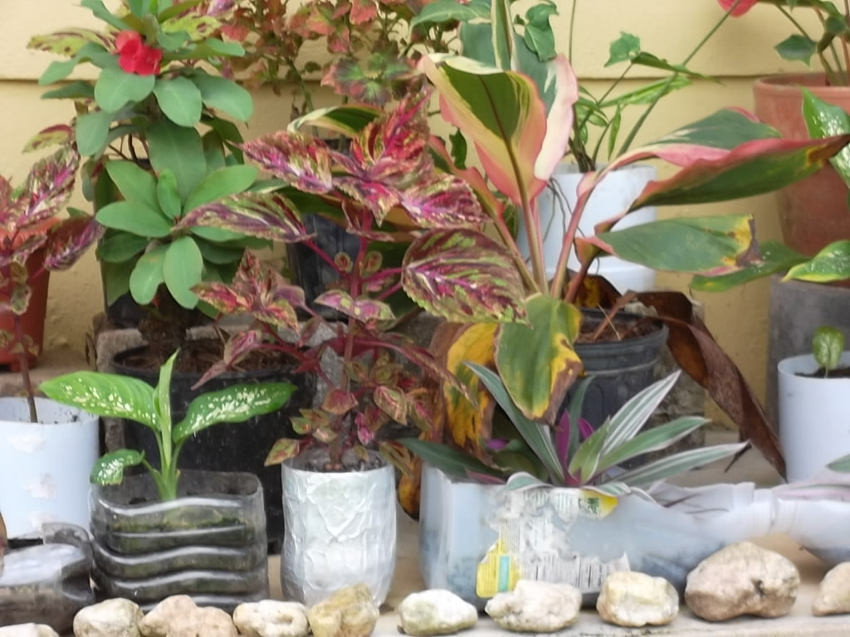
benefits of organic gardening
Ornamental plants cultivated organically beautify our living surrounding habitat. It enhances aesthetics of our place.

Slide 14
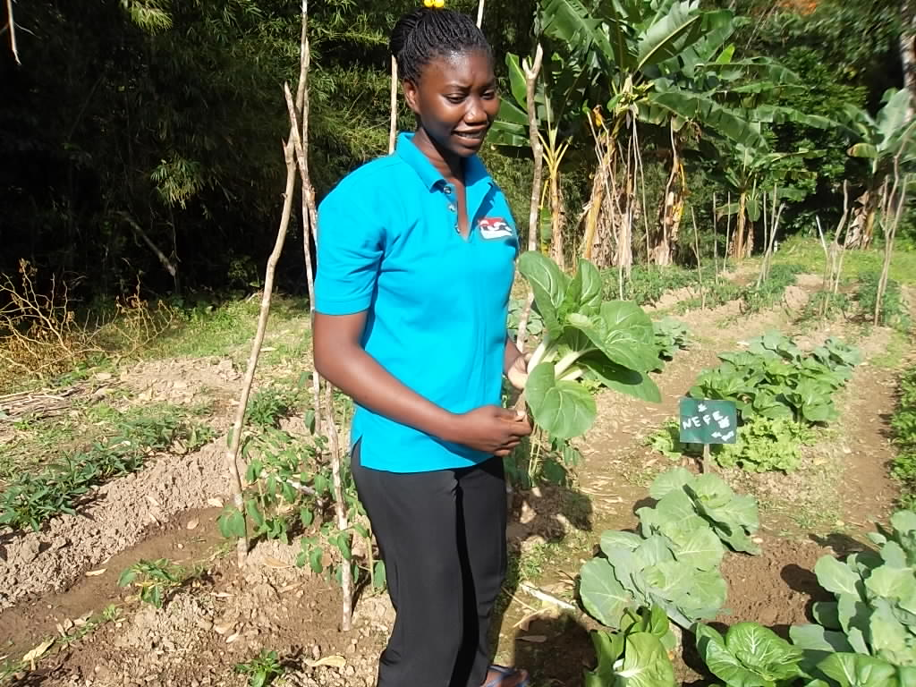
benefits of organic gardening
Organic gardening offers us physical exercise for our body in the nature.
It is environment friendly; the natural eco-systems are not affected through its practice.
We develop appreciation for God’s nature and learn of our Creator.

Slide 15
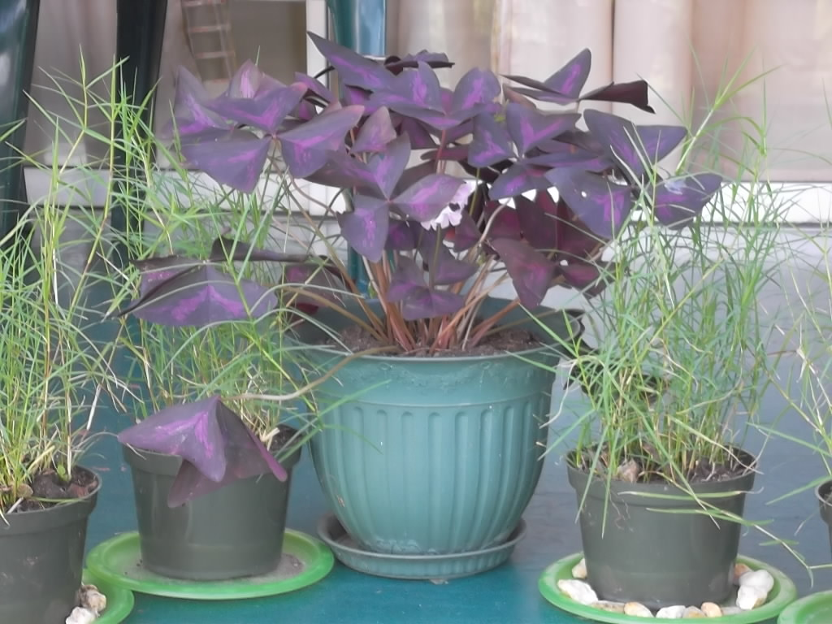
Requirements for Organic Gardening
Any person who wishes and have desire to grow plants can practice organic gardening either at home or at workplace, provided some land is available and permission is obtained for its use.
Landless gardening is practiced in boxes and containers. Anyone can do organic gardening anytime and anywhere.

Slide 16
Requirements for Organic Gardening
Remember, in fertile soil all plants do well.
We need gardening tools like fork, cutlass, hoe etc, for preparation of land for gardening.
We can begin gardening in our backyards. Cut down branches of trees and shrubs around your house to get some hours of sunshine for plants every day.
Plants prepare food through photosynthesis therefore we seek sunshine.
Pull out weeds so that insects will not have place to habitat around them. Insects cut, bite and draw sap from plant parts like leaf, stem, and flower and finally destroy plant.

Slide 17
Requirements for Organic Gardening
Soil fertility need to be maintained all the time for plants to bear flowers and fruits.
In organic gardening we depend on plants and animals for supplying organic manures for maintaining soil productivity.
The organic manures like Farm Yard Manure (FYM), compost, and Gobar- animal based manure do well in increasing organic matter in the soil.
We can enhance soil fertility through green manuring, vermiculture and through crop rotation.

Slide 18
Requirements for Organic Gardening
Farm Yard Manure (FYM)
comprises of plant wastes and animal litter.
All decomposable matter from plants and animals sources decay after some time.
Those farmers who practice mixed farming (plants and animals are raised together on a farm) make FYM.
Compost
It involves decomposing of plant remains.
Mostly leaves are used but other parts of plants can also be utilized for compositing.

Slide 19
Requirements for Organic Gardening
Green manure
In green manuring, the plants that are leguminous (like beans, peas) are grown for two months period and ploughed back into the soil.
Gobar
Gobar is organic manure that is collected from cattle farms.
When it is decomposed it is mixed into the soil.
It is an excellent organic manure.

Slide 20
Vermiculture
Vermiculture is a practice of raising earthworms for agriculture.
These earthworms are nature’s gift for cultivating our soil for any agricultural activities.
They make soil fertile. Plants do well where earthworms are present in the soil.

Slide 21
Conclusion
Plants and animals grow healthy when organic gardening is practiced.
The food harvested from organic gardening is safe and healthy for our human consumption.
Organic farming and organic gardening are the best agricultural practices for this 21st century.
Grow organically and enjoy optimum health.

Slide 22
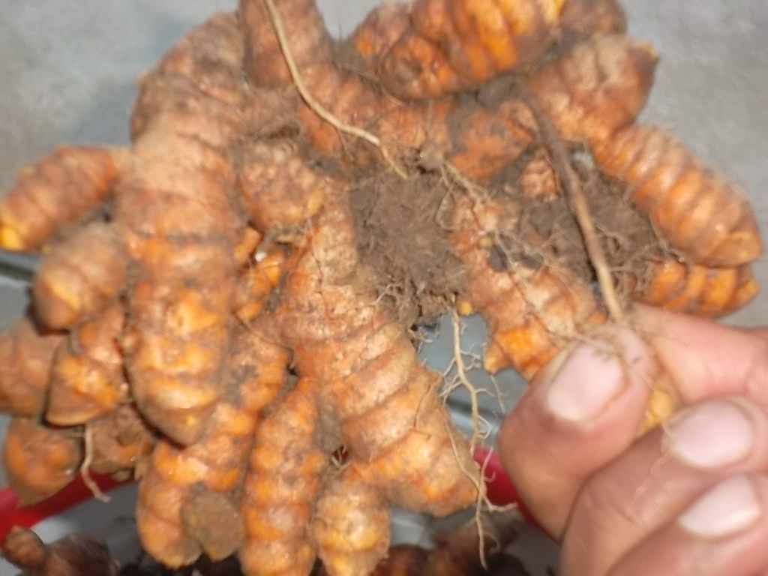
Organic Produce : turmeric

Slide 23
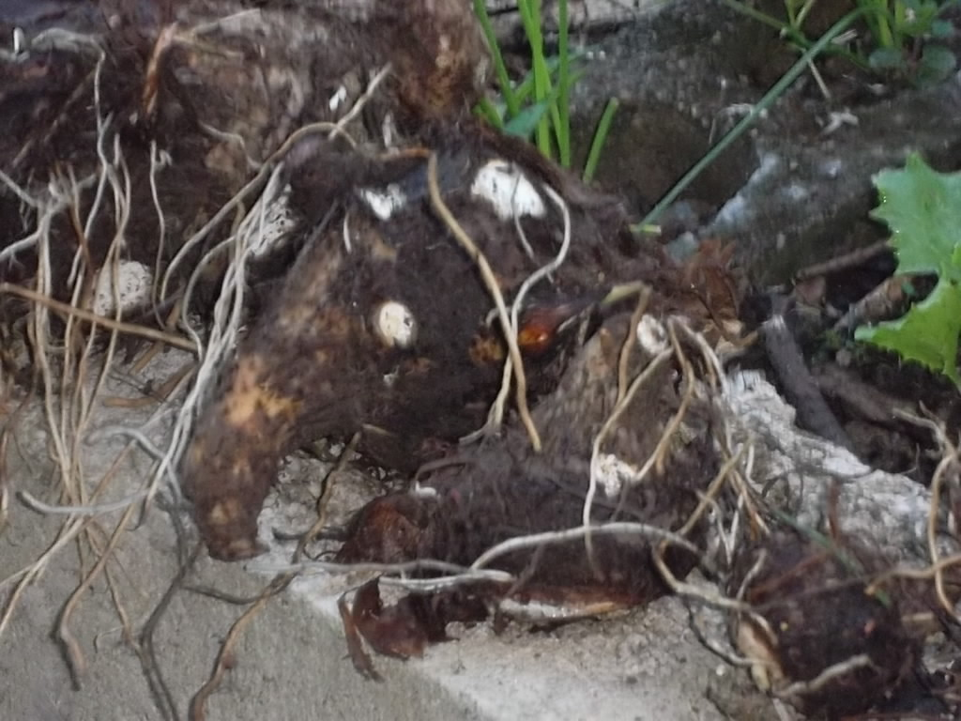
Organic Produce : dasheen

Slide 24
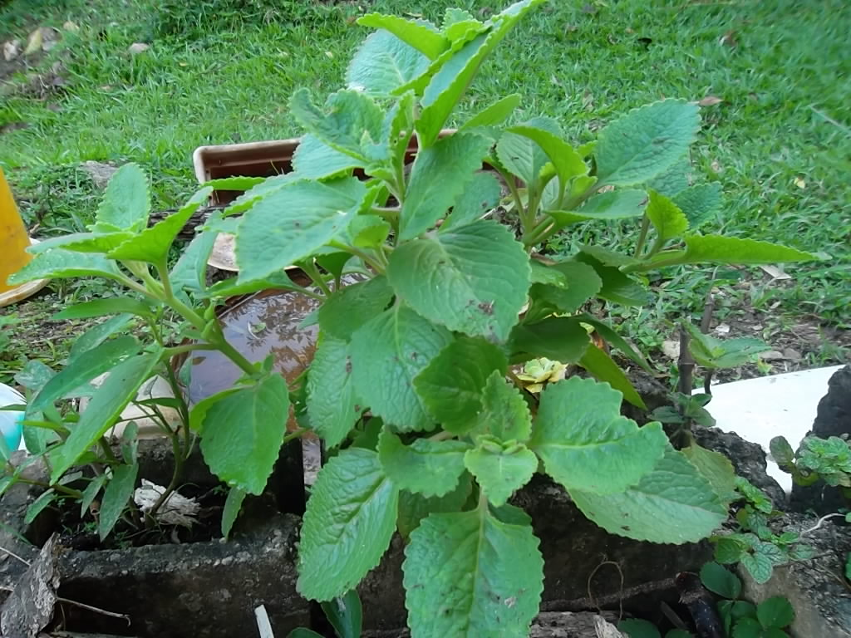
Organic Produce: thyme

Slide 25
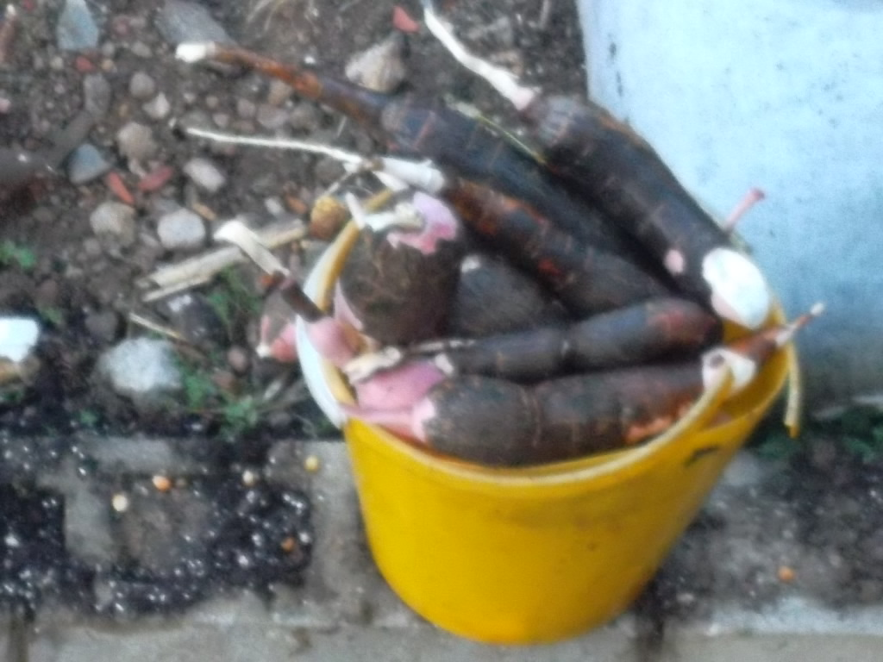
Organic Produce:cassava

Slide 26
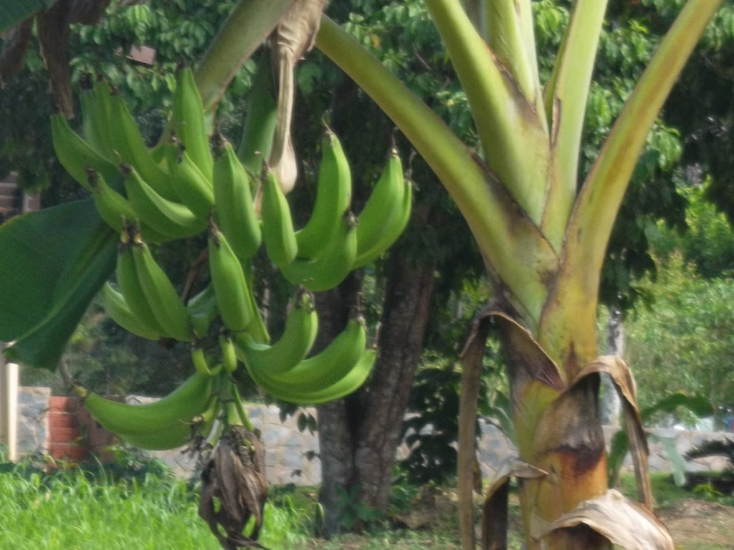
Organic Produce : plantain

Slide 27
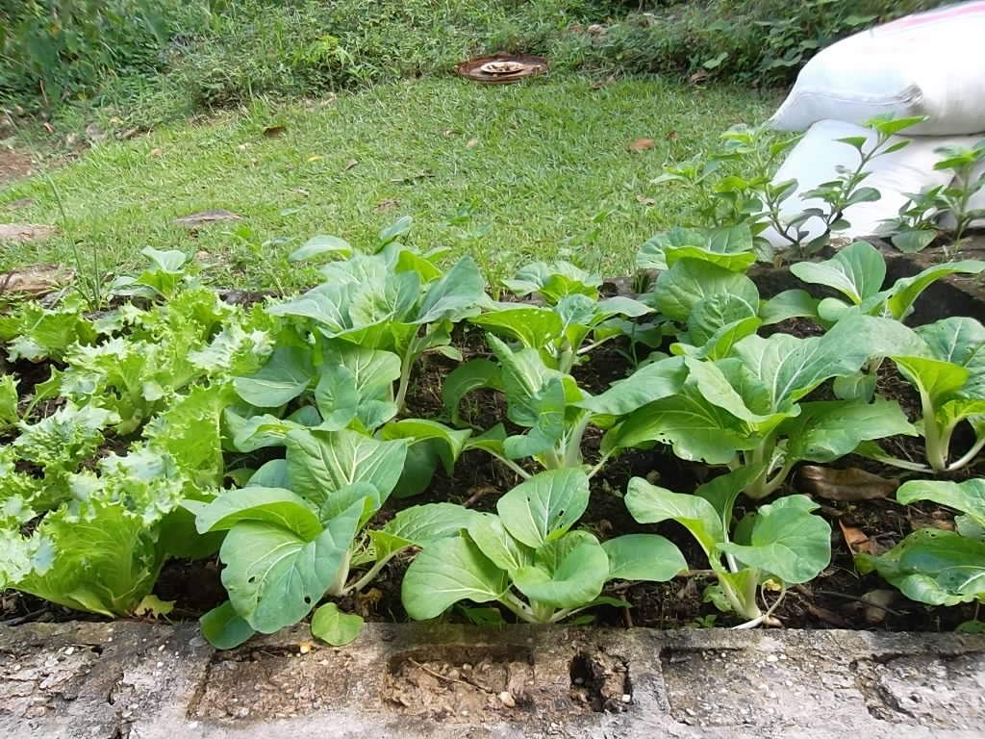
Organic Produce : Patchoi

Slide 28
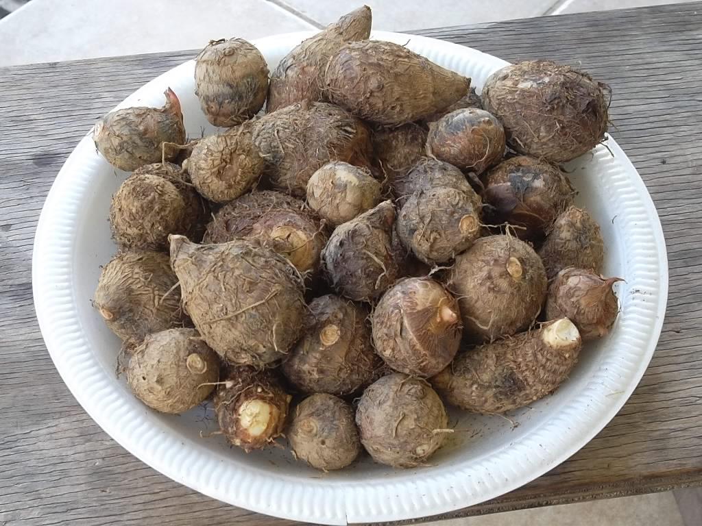
Organic Produce : eddoes

Slide 29
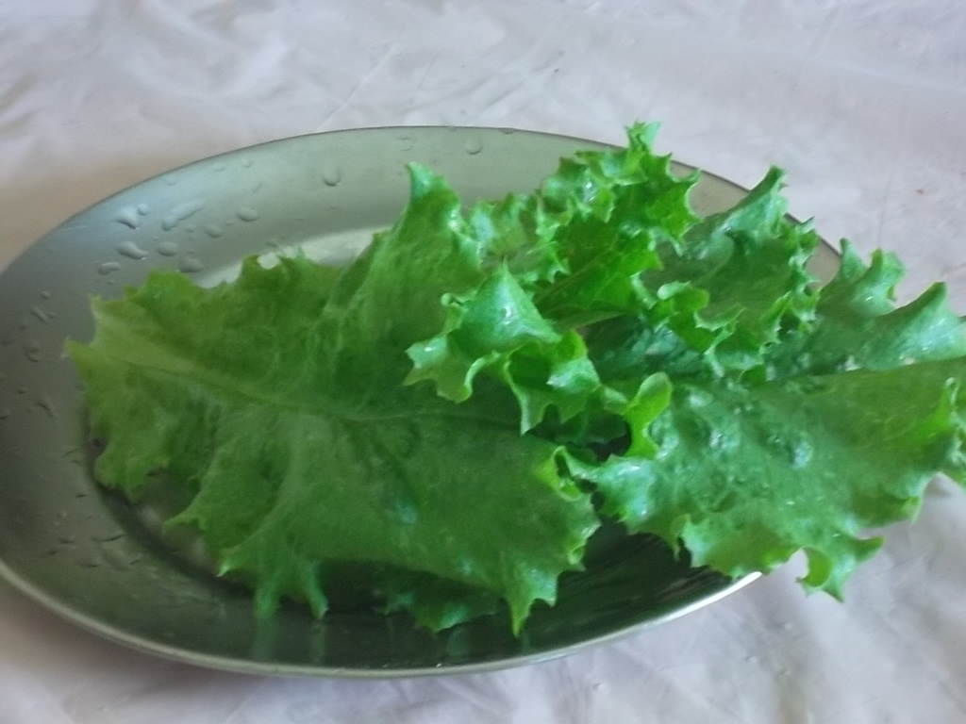
Organic Produce : lettuce

Slide 30
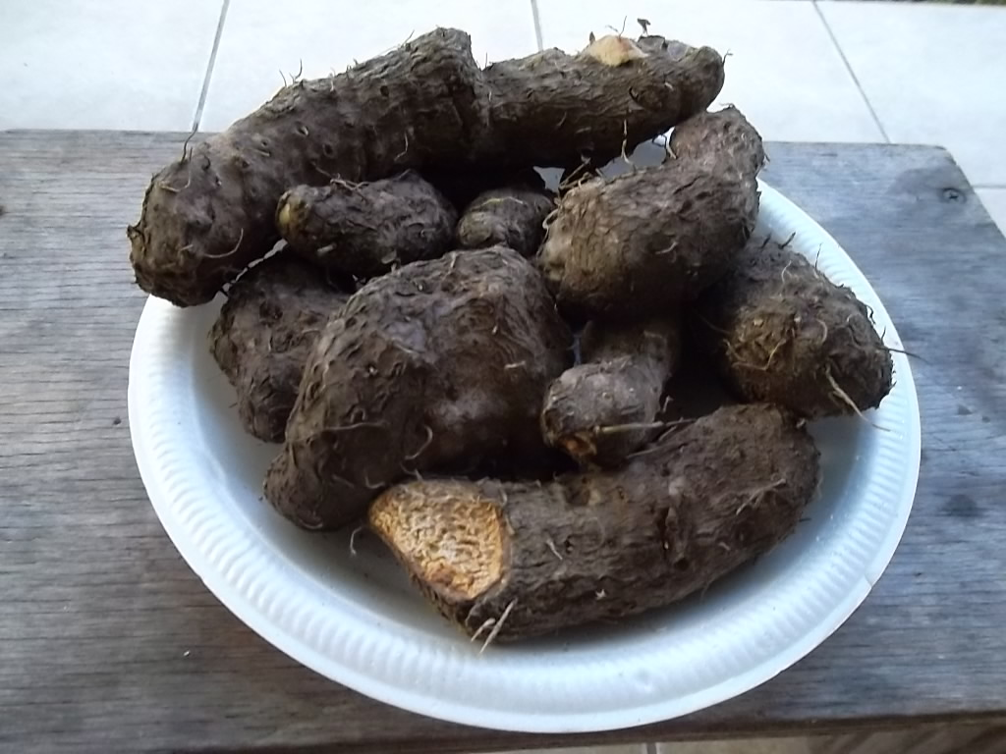
Organic Produce : Yam

Slide 31
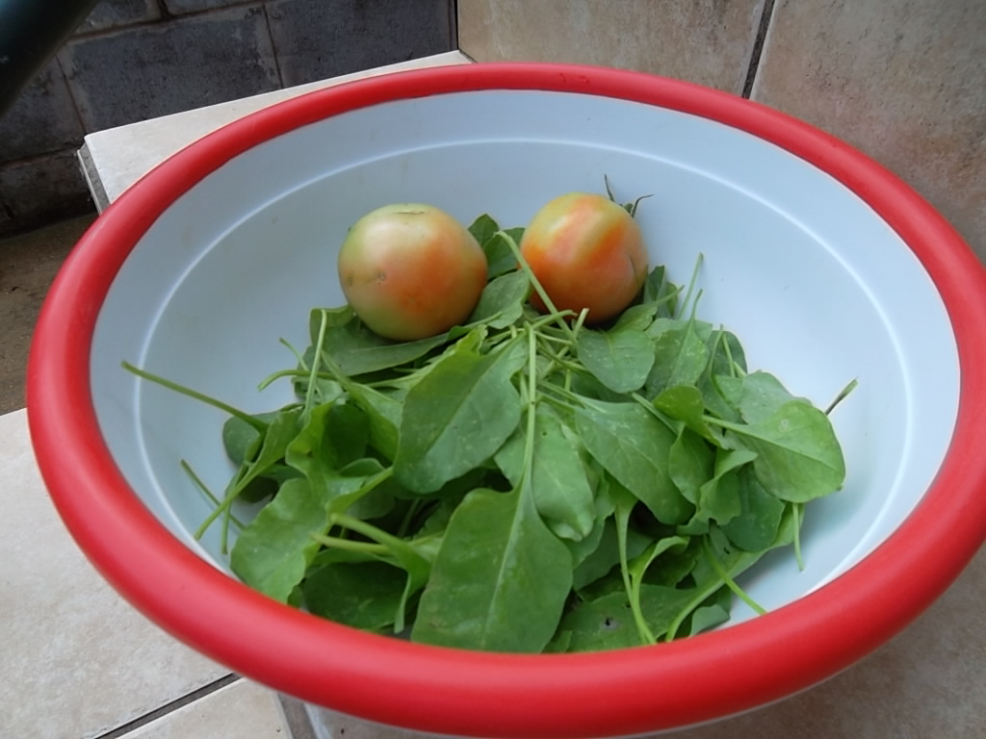
Organic Produce

Slide 32
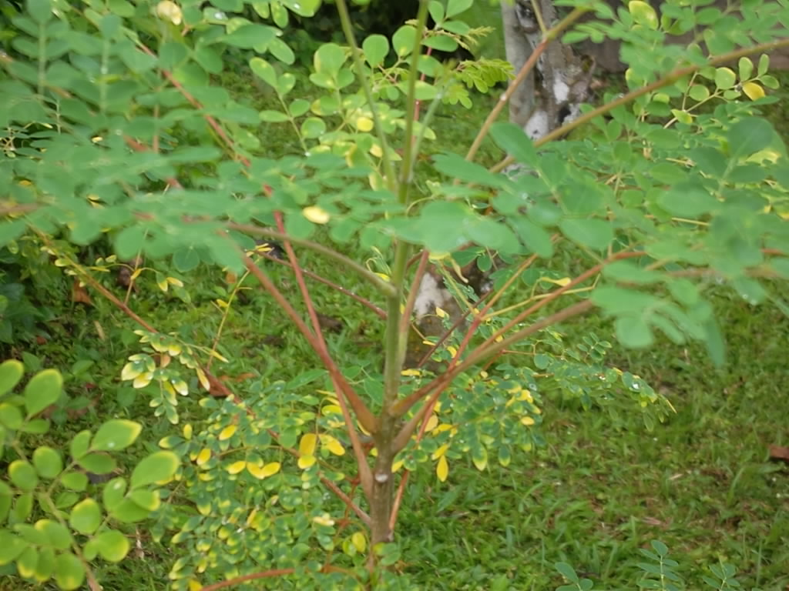
Organic Produce :moringa

Slide 33
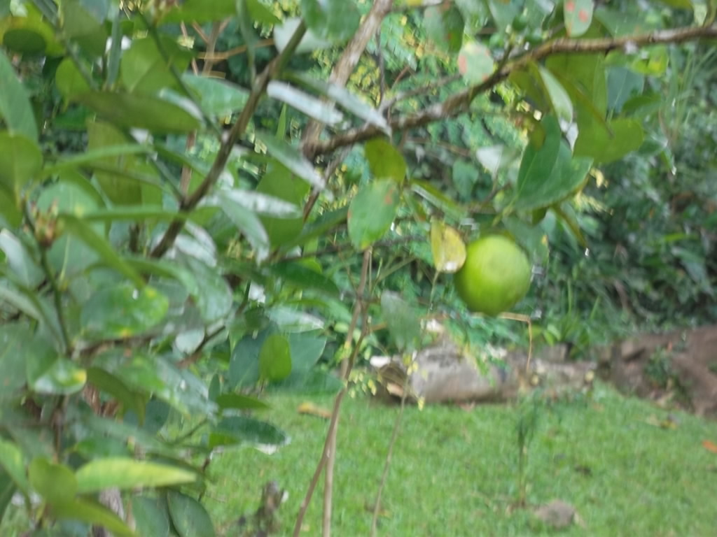
Organic Produce : lime

Slide 34
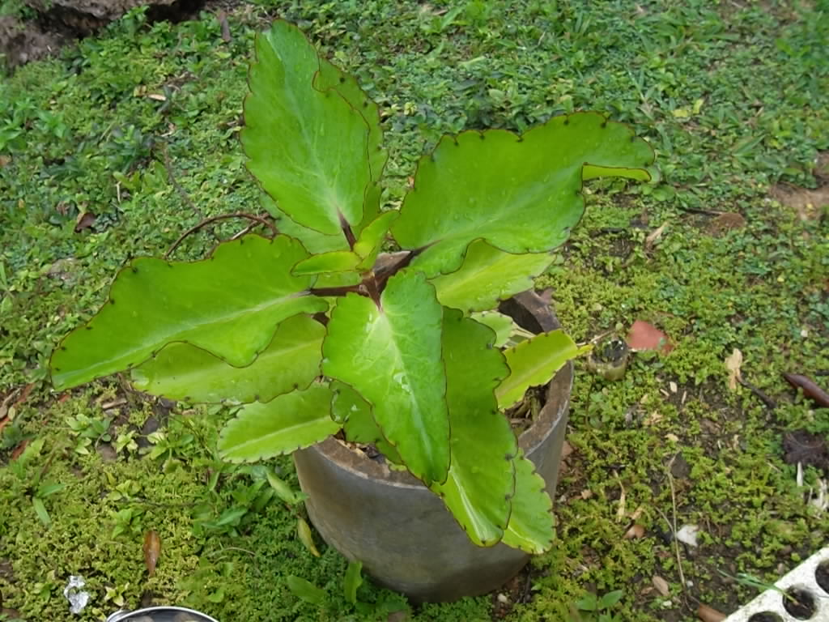
Organic Produce : bryophyllum

Slide 35
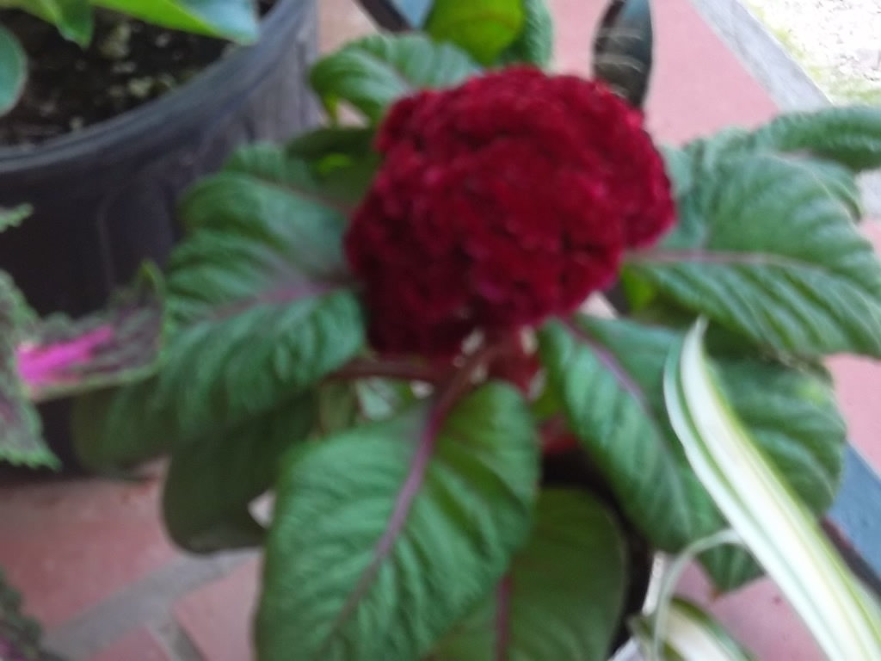
Organic farming
The earth is the LORD’S, and the fullness thereof.
(Psalm 24:1)

