Slide 1
Medical Missionary Conference
Health Evangelism in the Cities
“Go ye into all the world, and teach all nations” Matthew 29:19

Slide 2
Health Evangelism in the Cities
“Grace is an attribute of God exercised toward underserving human beings. We did not seek for it, but it was sent in search of us. God rejoices to bestow His grace upon us, not because we are worthy, but because we are so utterly unworthy. Our only claim to His mercy is our great need.”
MH, p. 161.
During the twentieth century the world experienced unprecedented urban growth. In 2007, for the first time, 50 percent of the world’s population was living in cities. More than 400 cities now host at least 1 million inhabitants: at least 20 cities have populations greater than 10 million.

Slide 3
Seeing the Big Picture
A commitment to the people of the world’s great cities is not a trendy modern impulse, but is instead firmly based on Christ’s ministry as seen in the Gospels and clearly explained in the writings of Ellen White. As Seventh-day Adventists we’ve often focused our work on rural and suburban areas while many of the great cities remain largely unentered. Several factors are responsible for this, including the undoubted difficulty of urban ministry and the fact that we have received inspired counsel from Ellen White about the desirability of country living.

Slide 4
Health Evangelism in the Cities
“Rich and poor, high and low, free and bond are God’s heritage. He who gave His life to redeem man sees in every human being a value that exceeds finite computation.”
“How little do we enter into
sympathy with Christ on that
which should be the strongest
bond of union between us and
HIM– compassion for depraved,
guilty, suffering souls, dead in
trespasses and sins!
The inhumanity of man toward
man is our great sin.”MH, p.163

Slide 5
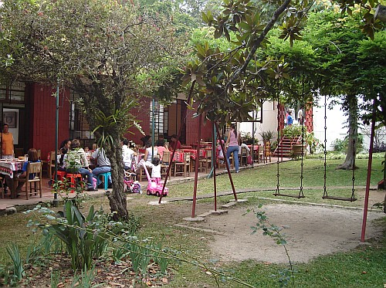
Health Evangelism in the Cities
Cooking Classes
Restaurant
Hydrotherapy/Message Clinics
Mobile Health Van
Health Food Store
Community Food Co-ops
Tutoring – all academic levels
Ministry for Battered and Abused Women
Orphans and Abandoned Children

Slide 6
Health Evangelism in the Cities
Drug Addiction, Alcohol and Substance Abuse Workshops & Clinics
Smoking Cessation Workshops and Clinics/Stop Smoking Workshops & Clinic

Slide 7
Health Evangelism in the Cities
God’s original plan placed human beings in a delightful garden, not a crowded city, but Ellen White is equally clear that we must accept and work with the situation as we find it today. The Spirit of Prophecy offers us a very balanced approach for ministering to large cities, clearly recognizing that many people, including many Seventh-day Adventists, may need or choose to live in the cities. An “in-out” approach by which those ministering in cities are encouraged to regularly recharge their spiritual and physical “batteries” in rural environments is a realistic and restorative approach to the tough realities of urban ministry.

Slide 8
Health Evangelism in the Cities
As Ellen White described it, “outpost centers”—including training schools, lifestyle health facilities, and missionary homes—would be established just on the edge of urban areas. A cycle of outreach moves the missionary into the city to engage with people on the level of their need, inviting responsive persons out to the outpost center for rehabilitation and recovery, and then returning with them to continue the cycle of witness. This in-out movement is essential for this special work, because God never intended believers to spend all of their lives in dense, overstimulated urban areas of the modern world.

Slide 9
Health Evangelism in the Cities
Background: Urbanization, Poverty and Health
Mobile Medical Van Ministry
Experts predict that the economic, social and political factors that drive urbanization will continue until the majority of people in most countries are living in urban areas
(Hardoy, Cairncross, and Satterthwaite 1990). In some of the world's largest cities, the poor already make up more than half the population, and their numbers are growing faster than those of other groups.
Until the mid-1990s, neither national policymakers nor international assistance agencies gave high priority to urbanization or urban poverty in Sub-Saharan Africa.

Slide 10
Health Evangelism in the Cities
To some degree, this made sense: rural populations greatly outnumbered urban in all but a few countries, and their much lower health and development indicators tended to justify a predominantly rural development approach.
The new millennium, however, has brought increasing recognition of changes in the population structure of needs of the urban poor and the need to pay more attention to their health and development.

